Slide 1
JavaScript IV
Web Development

Slide 2
Learning Objectives
What is Document Object Model?
What is the usage of DOM?
How does it relate to a web page?
How does usage of Document Objects help in web applications development?
What is Browser Object Model ?
What are the available Browser objects?
How does usage of Browser Objects help in web applications development?

Slide 3
Document Object Model
When a browser loads a web page, it also remembers the structure of the web page.
The structure contains information about the HTML tags, their attributes, and the order in which they appear in the file.
Such structure or model is called the Document Object Model (DOM).
Different documents are different in their structures.
The DOM lets JavaScript communicate with and change a web page.

Slide 4
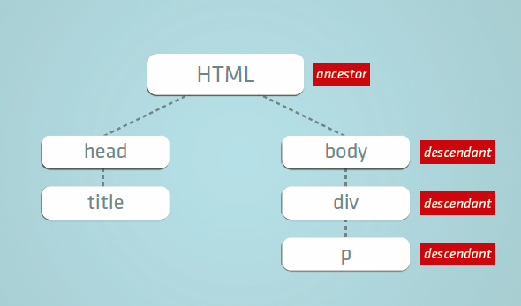
Document Object Model
parent
child
sibling
sibling
Each of the tags/elements and text are called nodes.

Slide 5
Document Object Model
Example: Basic structure of a HTML page
html
<html>
<head>
<title>A web page</title>
</head>
<body>
<h1>A header</h1>
<p>Some <strong>important</strong>
text
</p>
</body>
</html>
head
body
title
p
h1
A web page
A header
Some
text
(text node)
(text node)
(text node)
strong
important
(text node)

Slide 6
Document Object Model
Example (branch)
<body>
<p>
View the
<span>DOM Tree<span>
</p>
<ul>
Unordered list
<li>item 1</li>
<li>item 2</li>
</ul>
</body>
body
p
ul
View the
span
unordered list
li
li
(text node)
(text node)
DOM Tree
Item 1
Item 2
(text node)
(text node)

Slide 7
Document Object Model
<table border="1">
<thead>
<tr>
<th>Heading 1</th>
<th>Heading 2</th>
<th>Heading 3</th>
</tr>
</thead>
<tfoot>
<tr>
<td colspan="3">Footer</td>
</tr>
</tfoot>
<tbody>
<tr>
<td>1</td>
<td>2</td>
<td>3</td>
</tr>
</tbody>
</table>
table
Example
thead
tfoot
tbody
tr
tr
tr
th
th
th
td
td
td
Heading 1
Heading 3
1
3
(text node)
2
td
Heading 2
Footer

Slide 8
DOM – Select an element/node
var special =document.getElementById("special");
or using CSS selector
var special=document.querySelector(“#special");

Slide 9
DOM – Select a group of elements/nodes
var links =document.getElementsByTagName("a");
a[0] is the first link in the group
var sLinks =document.getElementsByClassName(“sLinks");
slinks[0] is the second link in the group
or using CSS selector
var allPhotos=document.querySelectorAll(".myPhotos");
allPhotos[0] is the first photo in the group
If use document.querySelector(“.myPhotos”) will only get the first element of myPhotos class.

Slide 10
Dynamically Change Text Content of Element
<h1 id="topic">How To Cook Rice</h1>
document.getElementById("topic").innerText="How to make coffee";

Slide 11
Dynamically Change HTML Content of Element
<div class="show">
<ol>
<li>Nasi Lemak</li>
<li>Ice Cream</li>
</ol>
</div>
document.querySelector(".show > ol").innerHTML=
"<li>coffee</li><li>Milo</li>";
Content will be taken as html tags but not text only.

Slide 12
Dynamically value of input Element
Change the value of a input element:
<label>
First Number <input id="first" type="number"/>
</label>
var value1=document.getElementById("first").value;

Slide 13
Dynamically Change attribute of element
<a href="http://www.google.com">I am a link</a>
<img src="logo.png">
var link = document.querySelector("a");
var destSite= link.getAttribute("href"); // get the destination
link.setAttribute("href", "http://www.dogs.com"); // get the destination
var img = document.querySelector("img");
img.setAttribute("src", "corgi.png");

Slide 14
Dynamically Change class name
If only one class
divShow=document.querySelector(".show");
divShow.setAttribute("class","hide");
If has element belongs to a list of classes
divShow=document.querySelector(".show");
divShow.classList.remove("show");
divShow.classList.add("hide");
Note: classList may not be supported by all browsers yet
Notes:
div=document.querySelector("h1+div");div.classList.remove("show");div.classList.add("hide");undefineddiv=document.querySelector("div:nth-child(3)");div.classList.remove("hide");div.classList.add("show");

Slide 15
Dynamically Change Style of Elements
Style of element can be dynamically changed, for example:
document.getElementById(“heading”).style.color=“red”
document.getElementById(“heading”).style.display=“none”
Note: Setting with the inline styles

Slide 16
Setting CSS style in JavaScript
Properties that consists of more than one words that join with hyphen :
For example: font-size
The hyphen is to be taken away and replace the first character of the next word with capital letter, such as:
document.getElementById(“p1”).style.fontSize

Slide 17
Dynamically Adding new Elements
New elements in a document can be dynamically added by adding child nodes to existing nodes.
Example of methods to be use for nodes operations:
var node=document.createElement(“h1");
node.innerText=“Hottest”;
document.getElementById(“newsDiv").appendChild(node);
show

Slide 18
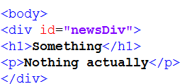
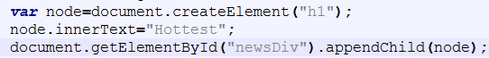
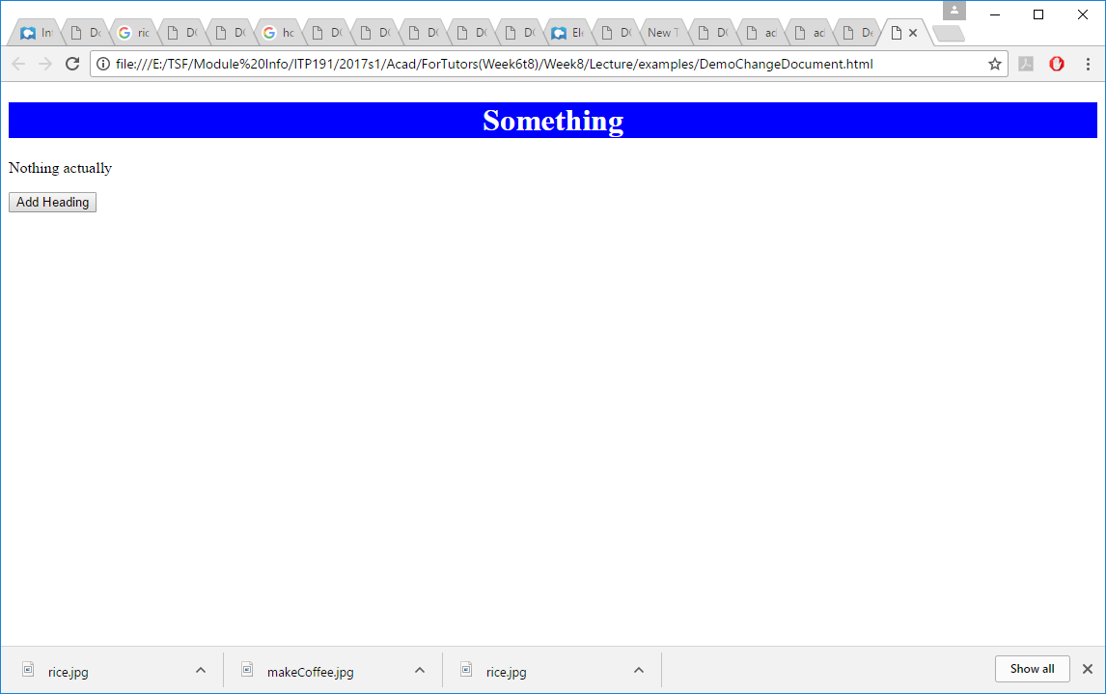
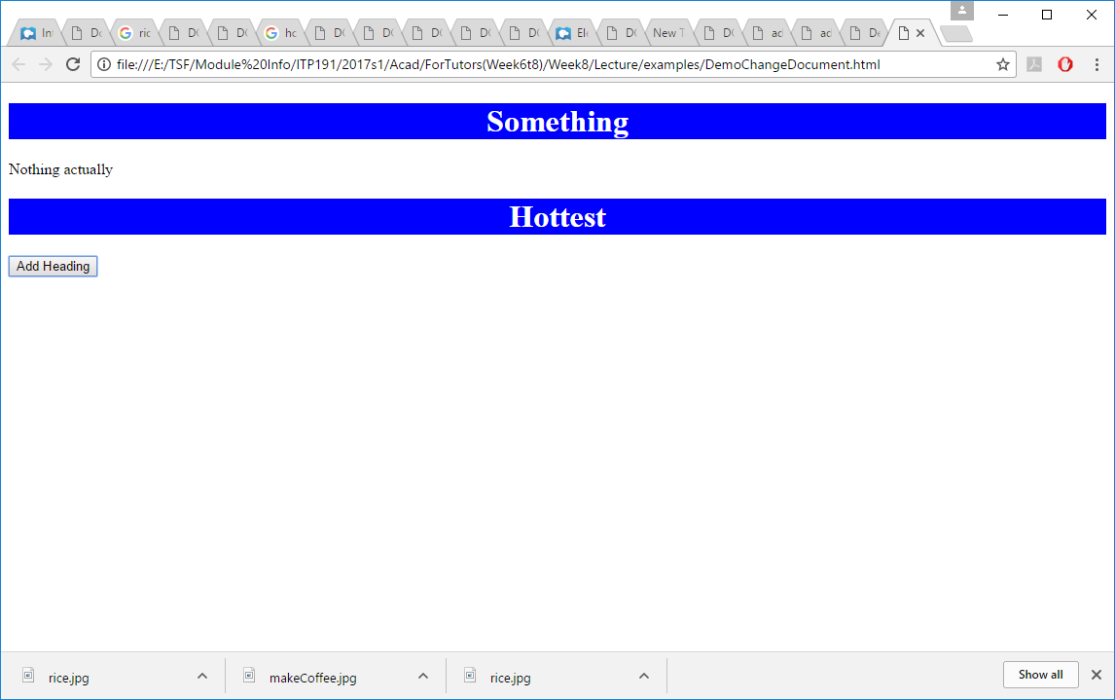
body
appendChild()
Id=“newsDiv”
div
input
node=createElement(“h1”)
element node
h1
p
h1
element node
Something
Nothing actually
node.innerText=“Hottest”
Hottest

Slide 19
Create TextNode vs setting innerText
var node=document.createElement("h1");
var textnode=document.createTextNode("Hottest");
node.appendChild(textnode);
document.getElementById("newsDiv").appendChild(node);
Use innerText is more convenient if the node only has text.
body
appendChild()
div
input
createElement(“h1”)
element node
h1
p
h1
element node
text node
Something
Nothing actually
createTextNode(“Hottest”)
Hottest
text node
appendChild()

Slide 20
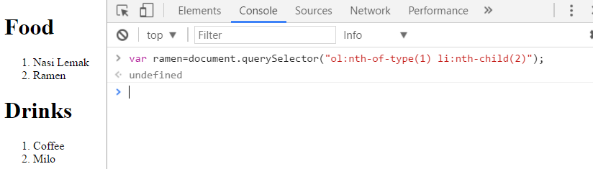
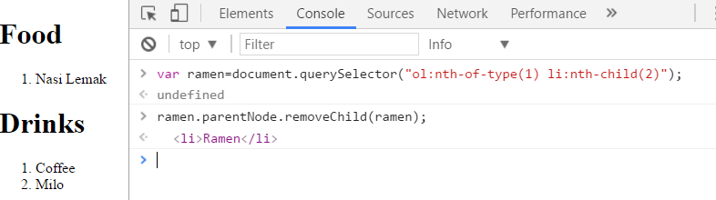
Dynamically remove Elements
To remove a node, need to find its parent. There is new way but not supported by all browsers yet
Refer to https://www.w3schools.com/js/js_htmldom_nodes.asp for more info

Slide 21
Events
Something happen
Actions that users perform, e.g.
Moving the mouse
Click on a button
Web browser operation, e.g.
Loading a document

Slide 22
Events (Cont.)
Mouse Event
click, dblclick, mousedown, mouseup, mouseover, mouseout, mousemove
Form Event
submit, reset, change, focus, blur, select
Keyboard Event
keypress, keydown, keyup
Others
load, unload, error, abort
View https://developer.mozilla.org/en-US/docs/Web/Events for reference of events

Slide 23
Ways to handle events
Through inline handler
Mixed with html tag (as an attribute of html element)
Easier to add, harder to maintain
One handler for one event
Register listener
Separated from html tag
Easier to maintain
Allow the queuing of multiple handlers for one event

Slide 24
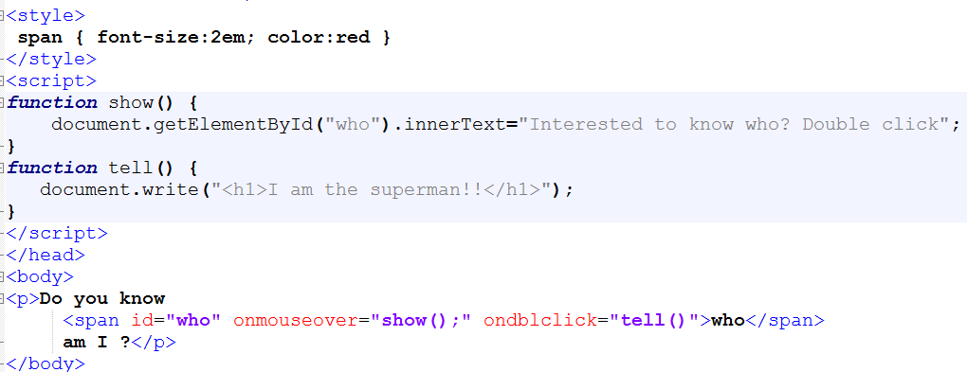
Handling an event – add inline handler
show

Slide 25
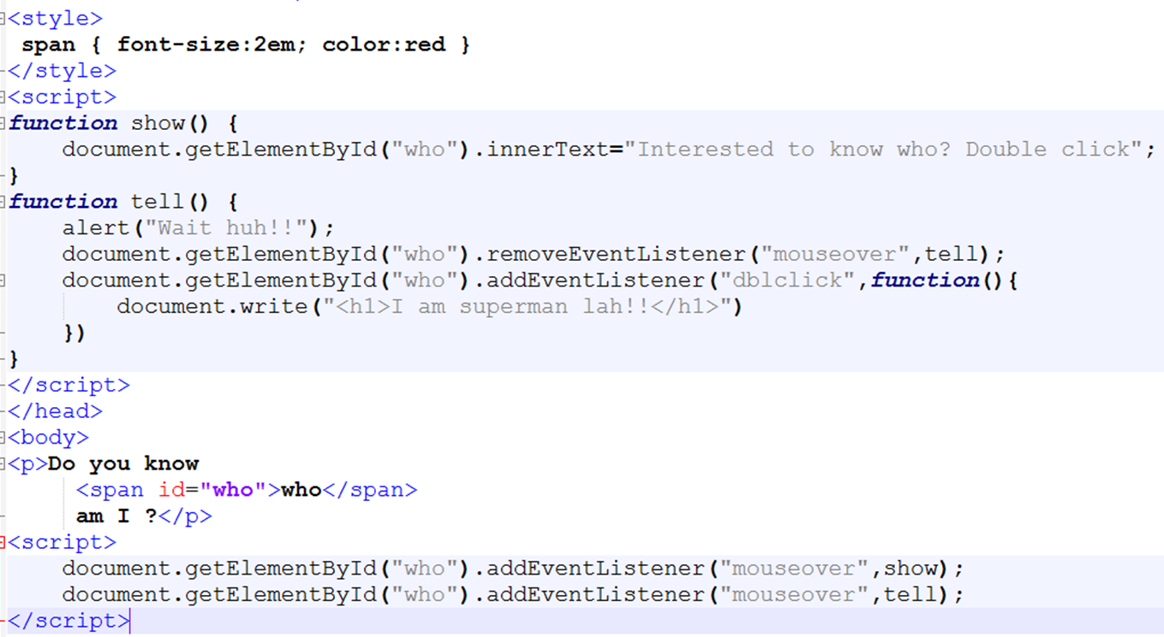
Handling an event – register listener
show

Slide 26
JavaScript Timing Events
setTimeout() - allows to run a function once after the interval of time.
setInterval() - allows to run a function regularly with the interval between the runs.
clearTimeout() - stop the execution of the function specified in the setTimeout() method.
clearInterval() - stop the execution of the function specified in the setInterval() method.

Slide 27
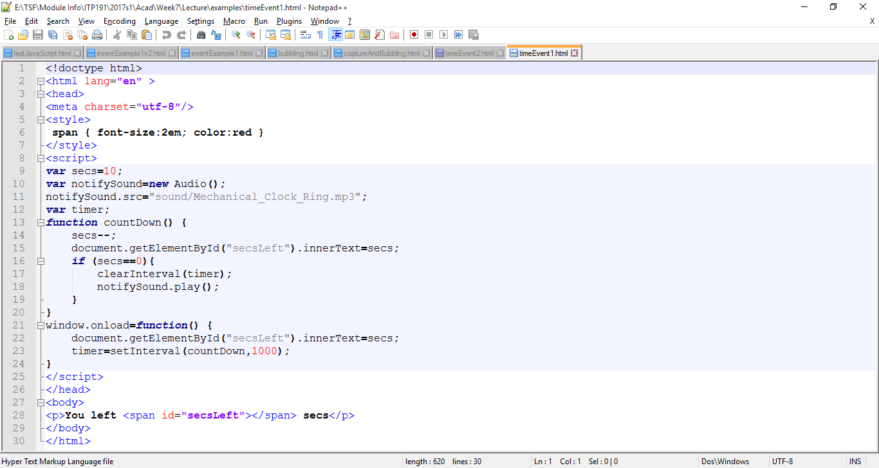
Example: Usage of setInterval
Count Down in 10 secs
Every one second update the display
When reach 10 secs, clear the timer
Show

Slide 28
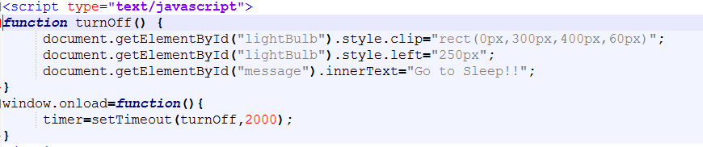
Example: Usage of setTimeout
2 secs later after the page load, turn off the light
Show

Slide 29
To set timer after document loaded
window.onload=function() {
timer=setTimeout(turnOff,2000);
}
Can also be written as
document.addEventListener("DOMContentLoaded",docIsReady);
function docIsReady(){
timer=setTimeout(turnOff,2000);
}
Or set the timer at the end of the document
timer=setTimeout(turnOff,2000);

Slide 30
Browser Objects
Objects of browser, such as window, document, navigator, screen, history, location
There is no official standard across all browsers
Browser objects allow JavaScript to interface and interact with the browser itself

Slide 31
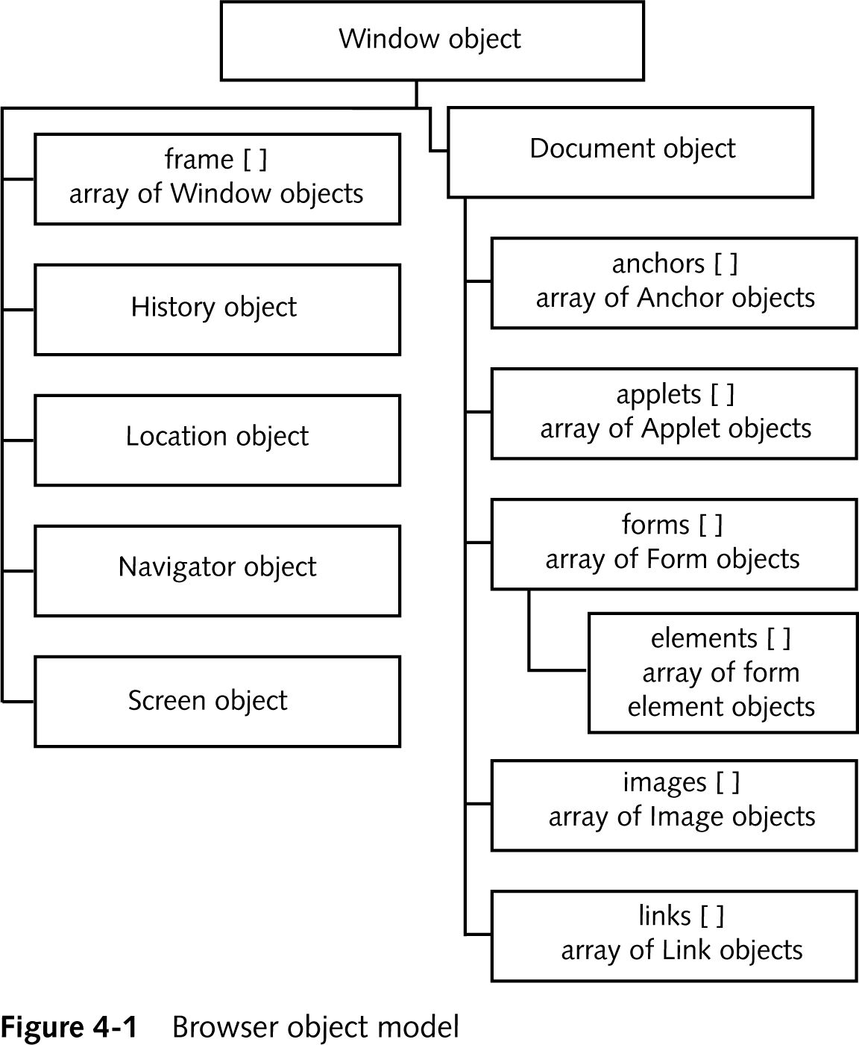
Browser Object Model (an Example)
Source from:JavaScript Third Edition by Don Gosselin, publisher :Thomson

Slide 32
BOM Object - window
function goNew(url){
var win1=window.open(url, "win1",
"toolbar=no,resizable=no, width=900px, height=600px")
}
<input type="button" value="go Google" onclick="goNew('http://www.google.com')"/>
<input type="button" value="go W3Schools" onclick="goNew('http://www.w3schools.com')"/>
Example

Slide 33
BOM Object - location
function go() {
var index=document.getElementById("searchTool").selectedIndex;
location.href=document.getElementById("searchTool").options[index].value;
}
<select id="searchTool" onchange="go()">
<option value="">select your search engine</option>
<option value="http://www.google.com">go google</option>
<option value="http://www.yahoo.com">go yahoo</option>
<option value="http://www.bing.com">go bing</option>
</select>
Example

Slide 34
BOM Object - navigator
<script type="text/javascript">
document.write("<b>Browser:</b> " + navigator.appName);
document.write("<br><b>Version:</b> " + navigator.appVersion);
document.write("<br><b>Platform:</b> " + navigator.platform);
</script>
Check browser

Slide 35
Browser Compatibility Issues
Different versions of browsers may be different in their support for such as
font availability
tags ( e.g. only supported by IE but not Netscape)
CSS styles & properties (not supported or appear differently)
DOM objects, methods….
http://www.netmechanic.com/products/Browser-Tutorial.shtml#1.2
Try to use the common standard tags and features(w3c)

Slide 36
Summary
What is Document Object Model?
What is the usage of DOM?
How does it relate to a web page?
How does usage of Document Objects help in web applications development
What is Browser Object Model ?
What are the available Browser objects?
How does usage of Browser Objects help in web applications development?

